Slide 1
ITU AI/ML in 5G challenge: ITU-ML5G-PS-004
Presentation Title : Depth Map Estimation in 6G mmWave systems
Team Name: SixG_ISAC
Team Github Repo: ITU-AI-ML-in-5G-Challenge/ML5G-PS-004-Depth-map-estimation-in-6G-mmWave-systems
Team Members:
Shubham Khunteta
Yeswanth Reddy Guddeti
Avani Agrawal
Ashok Kumar Reddy Chavva
Affiliation : Beyond 5G Team, Samsung R&D Institute India, Bengaluru.
Problem Organizer: NIST, USA.

Slide 2


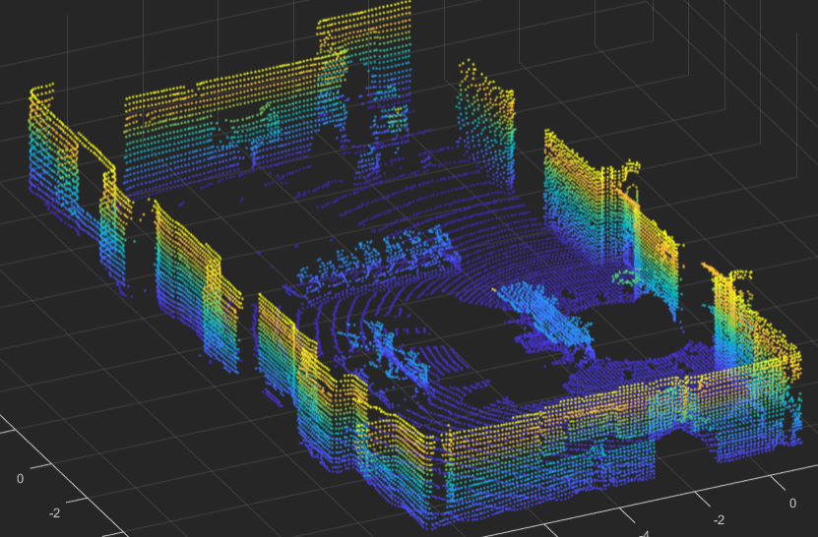
Motivation : Communication waves to create Digital world
Physical world
Digital world
ISAC + AI/ML
ISAC Networks
Inference using RF communication signal
Reuse spectrum, devices and protocols to perform both communication and sensing.
Extra processing required to acquire multi-dimensional data
Notes:
Keep cost and power of future networks under control

Slide 3
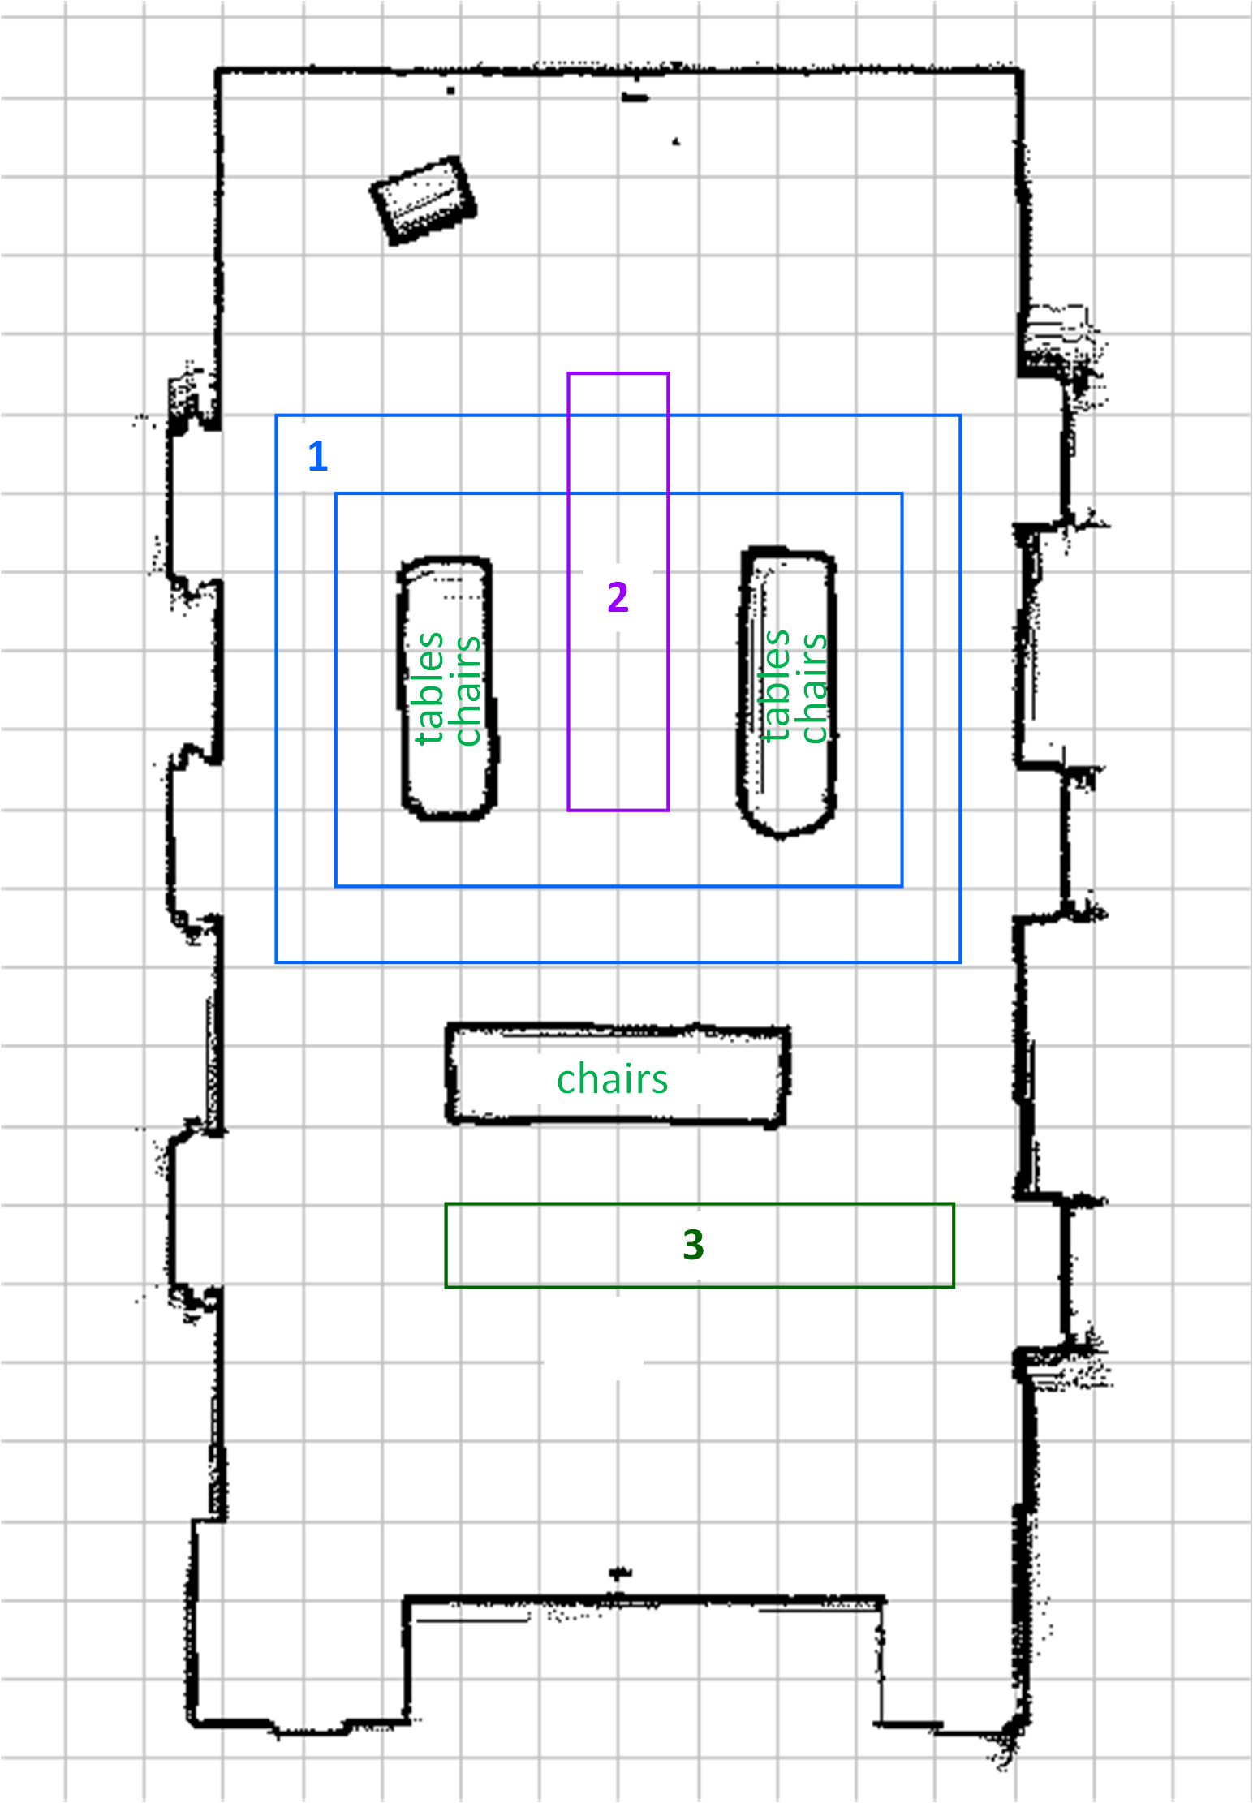
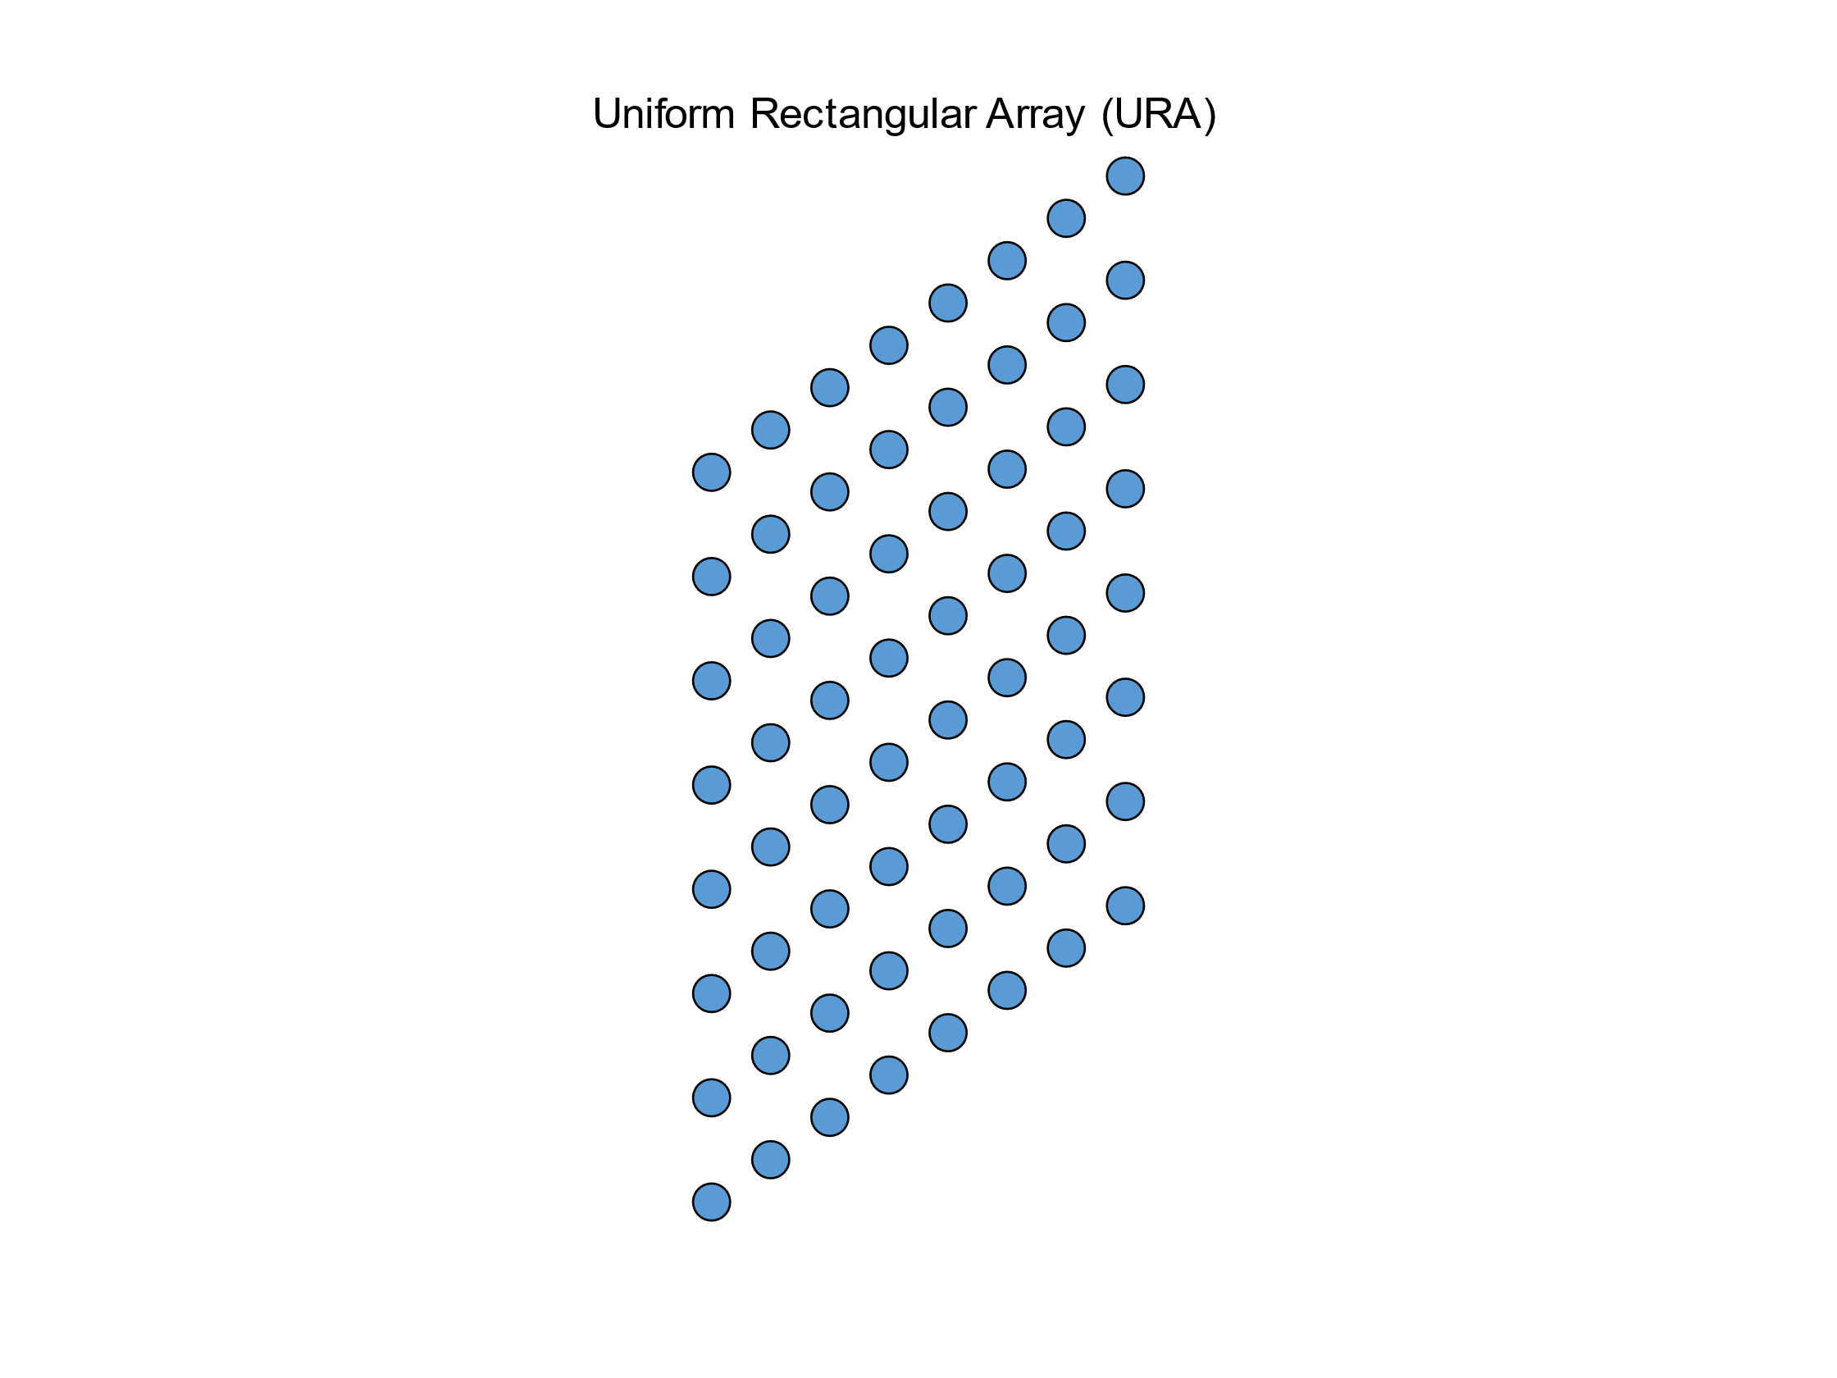
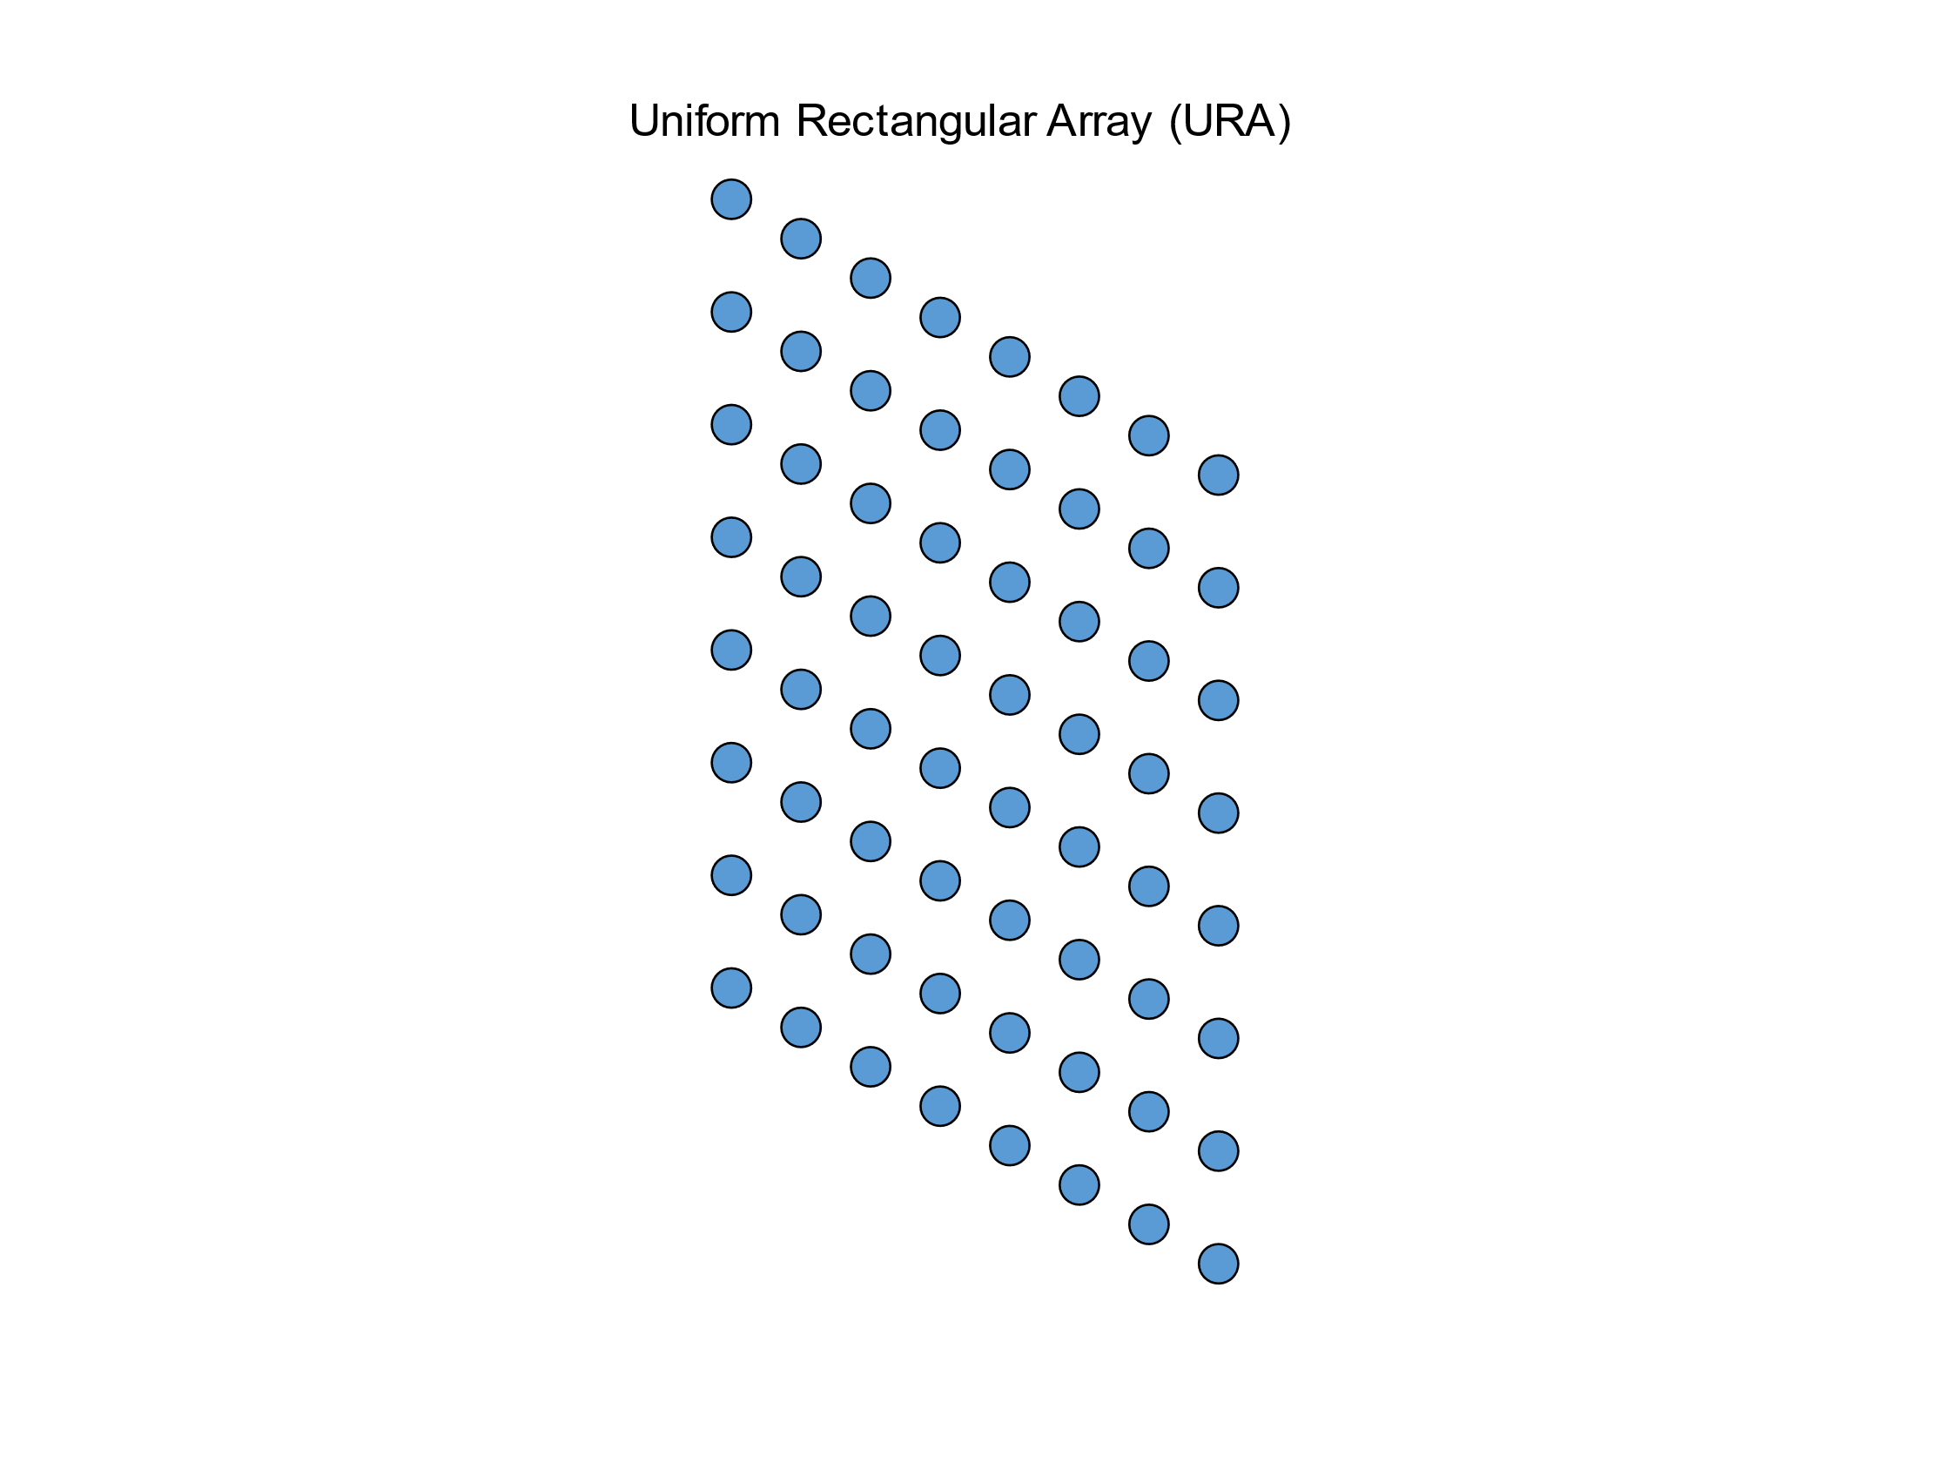
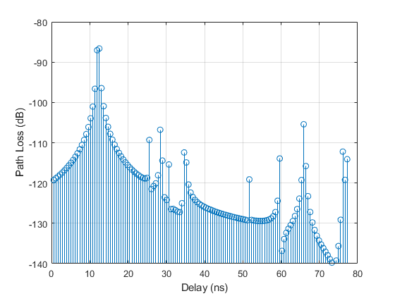
Problem statement
Problem statement
Input : MIMO channel Impulse response between
RX
8×8
8×8
One fixed transmitter
One moving receiver
TX
Evaluation :
Input Data:
Training RF Dataset
Trained Model
Output: LiDAR Point Clouds
Challenge : Estimate the depth map of the environment at each receiver position, using mm-wave signals + ML.
Notes:
This is challenge. So we have to develop a ML model that takes in MIMO RF data and outputs the estimated depth estimation of the environment in form of point clouds as if they are generated by LIDAR.

Slide 4
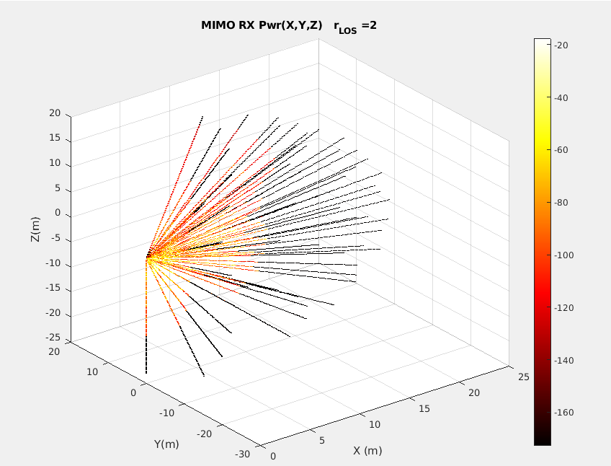

Solution
Training :
Input Data:
Training RF Dataset
Pre-processing
Machine-Learning
^{Training Dataset}
TX
RX
RX
Trained Model
Ground Truth:
Training LiDAR dataset
TX/RX
Solution : At each RX location
Transform bi-static MIMO data to mono-static format.
Train ML model by fitting it to similarly structured LiDAR ground truth.
Notes:
To generate such model, lets look at the how the mimo data is generated and how lidar data is generated.
As you can see, MIMO data is in what we call bistatic mode i.e the transmission & reception are physically separable locations.
Whereas Lidar sends and receives laser light signals from the same location.
In essence, we are attempting to take MIMO channel data that is bi-static (physically separable TX, RX) and fit it to LIDAR data that is mono static (same antenna as TX & RX).
Why do you need to transform to mono static data before sending to ML?
We wanted to make the training part of model more simpler & explainable . If not done, model should be itself learn about existence of MIMO TX and its location and other features thorough a large amount of training data which is of-course not guaranteed and depends on ML architecture.
So Pre-processing step handles the deterministic aspects of transforming MIMO channel data which is a function of TX, RX, environment to Lidar data which is function of RX, environment.
In addition, we wanted to handle the deterministic aspects of model fitting like data transformations outside the DL model training.
Since we are aware of what part of model learns what? this makes improving the overall model with further additional features much easier.

Slide 5
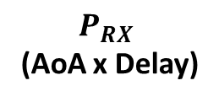
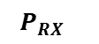


Pre-processing
Pre-processing
$H_{CIR}$
${ P}_{RX}$
(TX Ant x RX Ant x Delay)
(AoA x Delay)
RX
RX
Input :
$H_{CIR}$
8×8
8×8
(TX Ant x RX Ant x Delay)
TX antenna
RX antenna
${ P}_{RX}$
(AoA x Delay)
Output :
RX
RX
Notes:
$H_{CIR}$ i.e MIMO channel Impulse response between TX antenna & RX antenna over Time
${ P}_{RX}$ i.e Power received across Angle-of-Arrival at RX

Slide 6
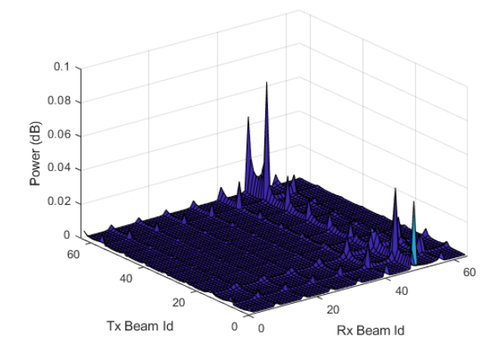
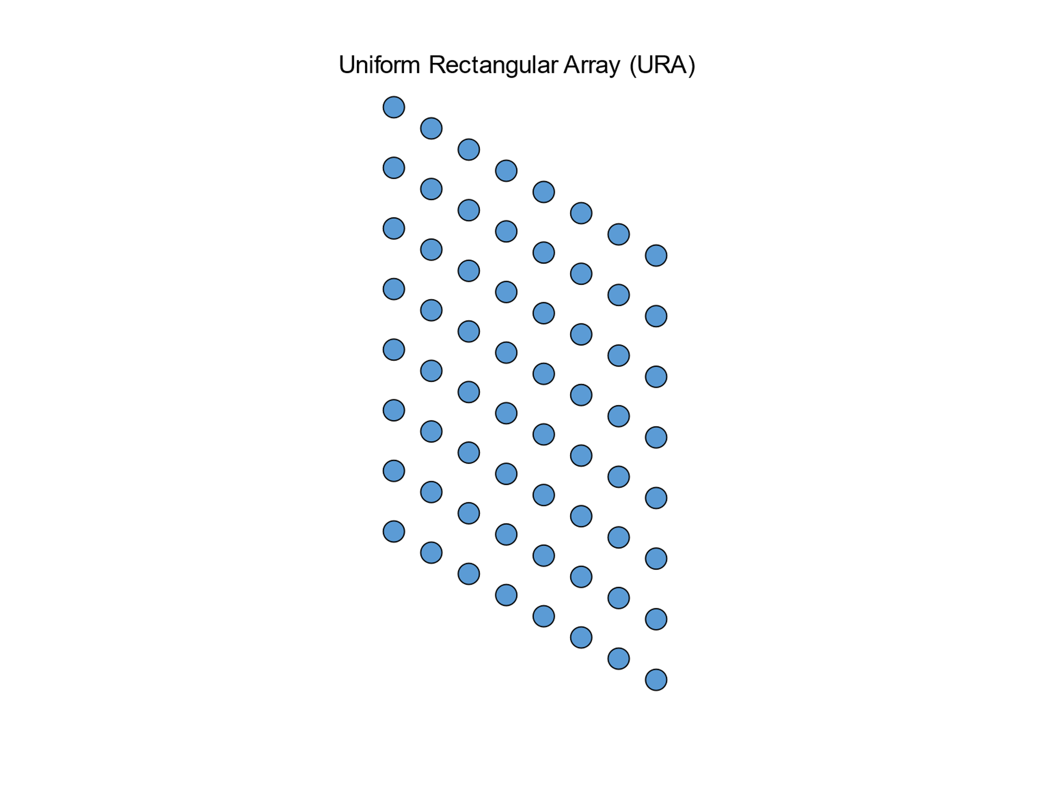
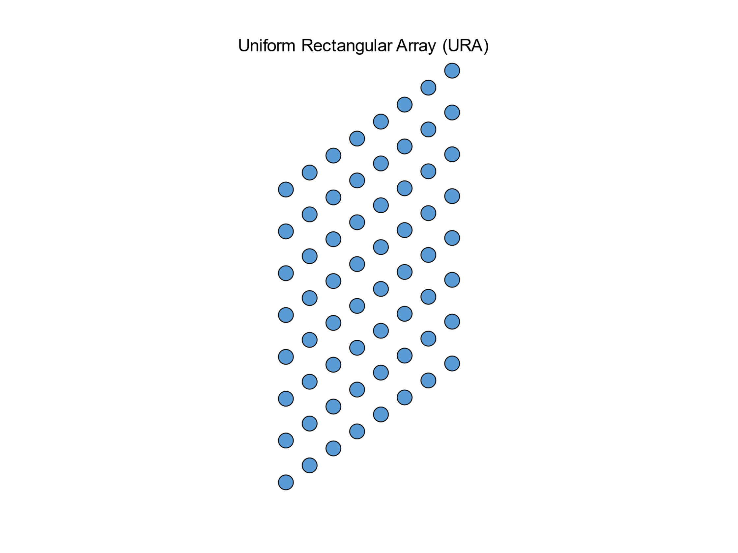
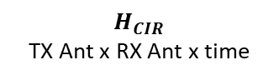


Pre-processing : Spatial Transform
$$H_{CIR}$$
TX Ant x RX Ant x time
$H_{CIR}$
Spatial transform
$H_{beam}$
(TX Ant x RX Ant x Delay)
(AOD x AOA x time)
TX
RX

Slide 7

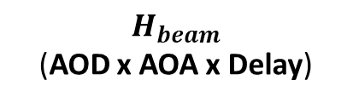
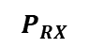
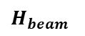
Pre-processing
Pre-processing
$H_{CIR}$
$H_{beam}$
${ P}_{RX}$
Spatial transform
RX
RX
TX
RX
$H_{beam}$
(AOD x AOA x Delay)

Slide 8
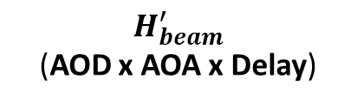
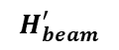
Pre-processing : Remove LOS
Pre-processing
$H_{CIR}$
$H_{beam}$
$$H_{beam}^{′}$$
${ P}_{RX}$
Spatial transform
RX
RX
1 : Remove LOS
TX
TX
RX
RX
$H_{beam}$
(AOD x AOA x Delay)
$H_{beam}^{′}$
(AOD x AOA x Delay)

Slide 9
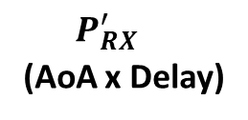
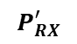
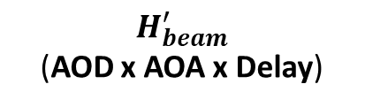
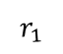
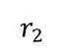
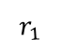
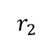
Pre-processing : Remove TX
Pre-processing
$H_{CIR}$
$H_{beam}$
$$H_{beam}^{′}$$
${ P}_{RX}$
Spatial transform
$$P_{RX}^{′}$$
RX
RX
$$r_{2}$$
$$r_{1}$$
$$r_{2}$$
$$r_{1}$$
2 : Remove TX
TX
RX
RX
$H_{beam}^{′}$
(AOD x AOA x Delay)
${ P_{RX}^{′}}_{}$
(AoA x Delay)

Slide 10
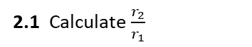

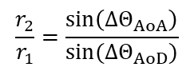
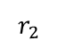
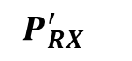
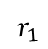

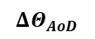
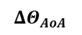
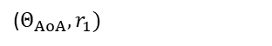
Pre-processing : Remove TX
Pre-processing
$H_{CIR}$
$H_{beam}$
$$H_{beam}^{′}$$
${ P}_{RX}$
Spatial transform
$$P_{RX}^{′}$$
RX
RX
2.1 Calculate $\frac{r_{2}}{r_{1}}$
2.2 : Project AOD to Delay
Delay
$$r_{2}$$
$$r_{1}$$
2 : Remove TX
$${(Θ}_{AoD},Θ_{AoA},r_{1}+r_{2})$$
AoD
($Θ_{AoA},r_{1})$
TX
$$ΔΘ_{AoD}$$
$$ΔΘ_{AoA}$$
RX
Delay
$$\frac{r_{2}}{r_{1}}=\frac{\sin\left(ΔΘ_{AoA}\right)}{sin⁡({ΔΘ}_{AoD})}$$
AoA
AoA
$H_{beam}^{′}$
${ P_{RX}^{′}}_{}$

Slide 11
Pre-processing : Remove TX
Pre-processing
$H_{CIR}$
$H_{beam}$
$$H_{beam}^{′}$$
${ P}_{RX}$
Spatial transform
$$P_{RX}^{′}$$
RX
RX
$$r_{2}$$
$$r_{1}$$
$$r_{2}$$
$$r_{1}$$
2 : Remove TX
TX
RX
RX
$H_{beam}^{′}$
(AOD x AOA x Delay)
${ P_{RX}^{′}}_{}$
(AoA x Delay)

Slide 12
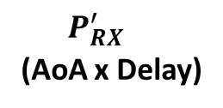
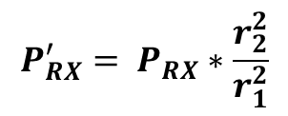
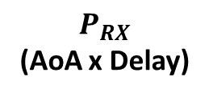
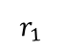
Pre-processing : Rescale power
Pre-processing
$H_{CIR}$
$H_{beam}$
$$H_{beam}^{′}$$
${ P}_{RX}$
Spatial transform
$$P_{RX}^{′}$$
${ P}_{RX}$
RX
RX
$$r_{1}$$
$$r_{2}$$
$$r_{1}$$
3 : Re-Scale power
RX
RX
${ P_{RX}^{′}}_{}$
(AoA x Delay)
$P_{RX}$
(AoA x Delay)
$${P_{RX}^{′}= P}_{RX}∗\frac{r_{2}^{2}}{r_{1}^{2}}$$

Slide 13
Pre-processing
Pre-processing
$H_{CIR}$
$H_{beam}$
1 : Remove LOS
${ P}_{RX}$
Spatial transform
2 : Remove TX
(AoA x Delay)
3 : Re-Scale power
RX
RX

Slide 14
Input and output for the ML model
Given Input:
CIR for Tx-Rx antenna pair 64x64
Input for the ML model:
Power values at:
64 directions : (8 Az x 8 El)
Each direction 100 points*.
Pre-processing
Rx
*Distance between consecutive points ~ 17cm
ML Model
Given Output (ground truth):
LIDAR PCD ~ 33k points for locations
Output for ML model
Voxel Grid:
Voxel size =0.25 m
Dim: 128 x 128 x 16
If any point of PCD is in a voxel:
Voxel value =1
Room dimesion:
X : -16 m to 16 m
Y: -16 m to 16 m
Z: -2 m to 2m

Slide 15
ML model architecture
From Pre-processing step:
Power values at:
64 directions : (8 Azimuth x 8 Zenith)
Each direction 100 points.
Rx
ML model: Hidden layers:
1 Fully connected layer
1 Up-sampling layer
3 CNN layers

Slide 16
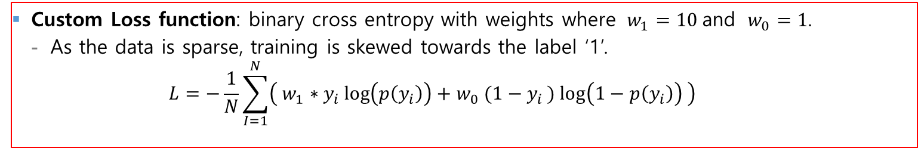
Training parameters
Custom Loss function: binary cross entropy with weights where $w_{1}=10$and $w_{0}=1$.
As the data is sparse, training is skewed towards the label ‘1’.
$$L=−\frac{1}{N}\sum_{I=1}^{N}{\left( w_{1}∗y_{i}\log\left(p\left(y_{i}\right)\right)+w_{0} (1−y_{i}) log\left(1−p\left(y_{i}\right)\right) \right)}$$
Total training samples : 3400 samples
Area 1 : 2400 samples
Area 3: 1000 samples
Validation samples : 350 (consisting of both the areas)
Test data: 529 sample of Area 2
Optimizer:
Adam
learning rate of 0.0005
Decay rate: 0.9 every 10000 steps
Epochs =100, batch size : 32.

Slide 17
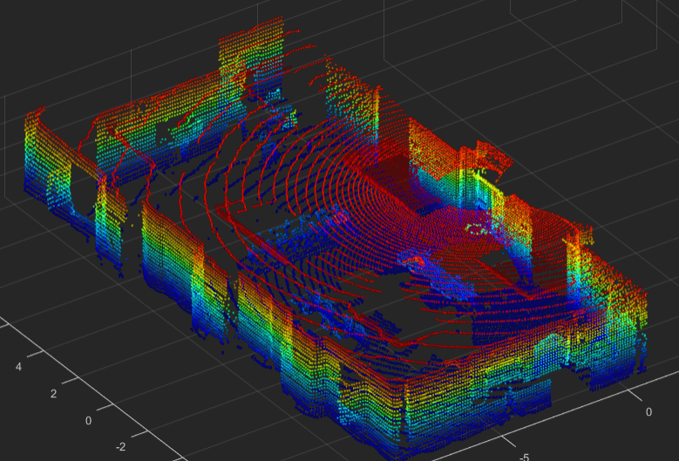
Evaluation for the challenge
Ground Truth: LiDAR Evaluation dataset
Trained Model
Input Data: RF Data Evaluation Dataset
Output: LiDAR Point Clouds
Evaluation
Training and evaluation dataset are collected in different areas of the room

Slide 18


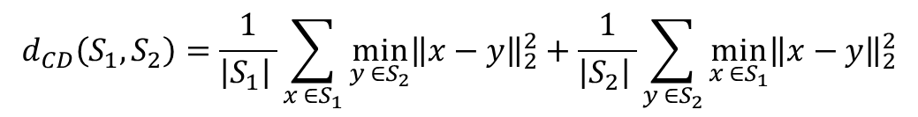
Evaluation Metric for the challenge
Chamfer Distance measures discrepancies between point clouds.
$$d_{CD}\left(S_{1},S_{2}\right)=\frac{1}{{\left|S_{1}\right|}_{ }}\sum_{x ∈S_{1}}{\min_{y ∈S_{2}}{{\left\|x−y\right\|}_{2}^{2}}}+\frac{1}{{\left|S_{2}\right|}_{ }}\sum_{y ∈S_{2}}{\min_{x ∈S_{1}}{{\left\|x−y\right\|}_{2}^{2}}}$$
Predicted PCD:
LIDAR PCD:

Slide 19
Evaluation : Error analysis on testing data

Slide 20
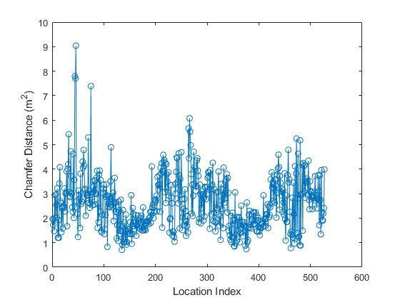
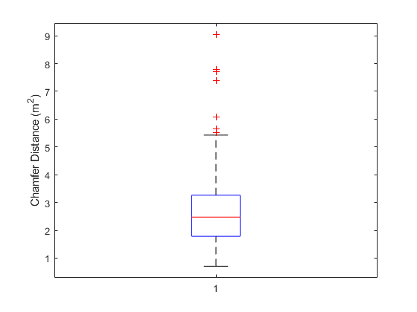
Evaluation : Error analysis on testing data

Slide 21
Questions ?

